Slide 1
Module 2: SQL(Structured Query Language)

Slide 2
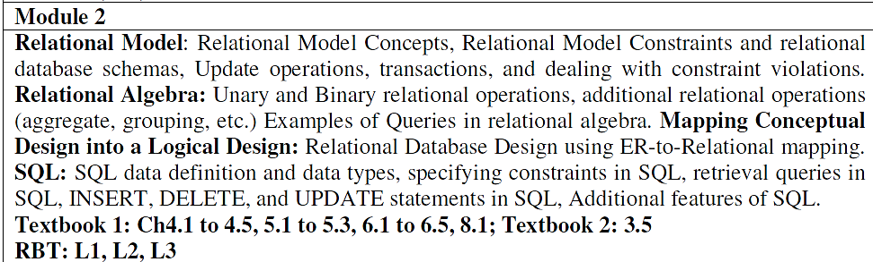
Module 2 Syllabus

Slide 3
Session Outline
Introduction to Structured Query Language (SQL)
Features of SQL
DDL Statements
DML Statements
Substring handling and other features of SQL

Slide 4
Introduction to SQL
SQL stands for Structured Query Language. It is used for storing and managing data in relational database management system (RDMS).
It is a standard language for Relational Database System. It enables a user to create, read, update and delete relational databases and tables.
All the RDBMS like MySQL, Informix, Oracle, IBM Db2, MS SQL Server or Hive use SQL as their standard database language.
SQL allows users to query the database in a number of ways, using English-like statements.

Slide 5
Structured Query Langauage (SQL)
SQL is a language used for interacting with Relational Database management Systems(RDBMS)
You can use SQL to get the RDBMS to do things for you
Create, retrieve, update and delete data
Create and manage databases
Design and create database tables
Perform administration tasks (Security, user management, import/export, etc)

Slide 6
SQL Rules
SQL follows the following rules:
Structure query language is not case sensitive. Generally, keywords of SQL are written in uppercase.
Statements of SQL are dependent on text lines. We can use a single SQL statement on one or multiple text line.
Using the SQL statements, you can perform most of the actions in a database.
SQL depends on tuple relational calculus and relational algebra.

Slide 7
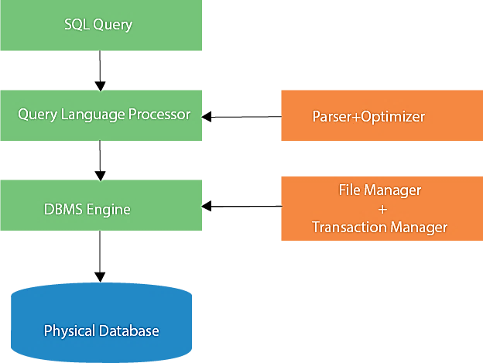
SQL process
When an SQL command is executing for any RDBMS, then the system figure out the best way to carry out the request and the SQL engine determines that how to interpret the task.
In the process, various components are included. These components can be optimization Engine, Query engine, Query dispatcher, classic, etc.
All the non-SQL queries are handled by the classic query engine, but SQL query engine won't handle logical files.

Slide 8
Characteristics of SQL
SQL is easy to learn.
SQL is used to access data from relational database management systems.
SQL can execute queries against the database.
SQL is used to describe the data.
SQL is used to define the data in the database and manipulate it when needed.
SQL is used to create and drop the database and table.
SQL is used to create a view, stored procedure, function in a database.
SQL allows users to set permissions on tables, procedures, and views.

Slide 9
Advantages of SQL
There are the following advantages of SQL:
High speed
Using the SQL queries, the user can quickly and efficiently retrieve a large amount of records from a database.
No coding needed
In the standard SQL, it is very easy to manage the database system. It doesn't require a substantial amount of code to manage the database system.
Well defined standards
Long established are used by the SQL databases that are being used by ISO and ANSI.
Portability
SQL can be used in laptop, PCs, server and even some mobile phones.
Interactive language
SQL is a domain language used to communicate with the database. It is also used to receive answers to the complex questions in seconds.
Multiple data view
Using the SQL language, the users can make different views of the database structure.

Slide 10
Disadvantages of SQL
With the advantages of SQL, it also has some disadvantages, which are as follows:
Cost
The operation cost of some SQL versions is high. That's why some programmers cannot use the Structured Query Language.
Interface is Complex
Another big disadvantage is that the interface of Structured query language is difficult, which makes it difficult for SQL users to use and manage it.
Partial Database control
The business rules are hidden. So, the data professionals and users who are using this query language cannot have full database control.

Slide 11
SQL Statements
Statement | Description
SELECT | Data retrieval statement
INSERT | Data Manipulation Language (DML) Add rows, change data, and delete few rows
UPDATE
DELETE
CREATE | Create new tables/views, remove tables/ views, and change the schema
ALTER
DROP
RENAME
COMMIT | Modified values of database are permanently written into disk, rollback the changes made
ROLLBACK
SAVEPOINT
GRANT | Access control can be assigned or changed
REVOKE

Slide 12
DDL Statements
Object | Meaning
Table | A tabular structure that stores data
View | A tabular structure similar to a table but it is a collection of one or more tables
Sequence | Automatically generates sequence of numbers for primary keys
Index | Provides an efficient access structure
Synonym | Gives alternate name to the object

Slide 13
Basic Data Types in Oracle
Data type | Description
CHAR (size) | Fixed length character. Max = 2000.
VARCHAR2(size | Variable length character string. Max = 4000.
DATE | Date. Vaild range is from to
BLOB | Binary large object. Max = 4GB.
CLOB | Character large object. Max = 4GB.
BFILE | Pointer to binary OS file.
LONG | Character data of variable size. Max = 2GB.
LONG RAW | Raw binary data. Rest is same as LONG.
NUMBER(size) | Numbers. Max. size = 40 digits.
NUMBER(size,d) | Numbers. Range = 1.0E-130 to 9.9E125.
DECIMAL | Same as NUMBER. size/d can't be specified.
FLOAT | Same as NUMBER.
INTEGER | Same as NUMBER. size/d can't be specified.
SMALLINT | Same as NUMBER.

Slide 14
DDL - Data Definition Language (Create Statement)
1. CREATE TABLE Statement
This SQL statement creates the new table in the SQL database.
Syntax of CREATE TABLE Statement:
CREATE TABLE table_name
(
column_name1 data_type [column1 constraint(s)],
column_name2 data_type [column2 constraint(s)],
.....
.....,
column_nameN data_type [columnN constraint(s)],
PRIMARY KEY(one or more col)
);

Slide 15
DDL - Data Definition Language:Example
CREATE TABLE EMPLOYEE
( Fname VARCHAR(15) NOT NULL,
Minit CHAR,
Lname VARCHAR(15) NOT NULL,
SSN CHAR(9) NOT NULL,
Bdate DATE,
Address VARCHAR(30),
Sex CHAR,
Salary DECIMAL(10,2),
Super_ssn CHAR(9),
DNo INT NOT NULL,
PRIMARY KEY (SSN),
FOREIGN KEY (Super_ssn) REFERENCES EMPLOYEE(SSN),
FOREIGN KEY (Dno) REFERENCES DEPARTMENT(Dnumber) );

Slide 16
DDL – contd…

Slide 17
DDL - Data Definition Language (Alter statement)
CREATE TABLE ITEMS (
ITEMID NUMBER(5),
ITEMNAME VARCHAR2(10),
PRICE NUMBER,
CONSTRAINT "ITEM_PK" PRIMARY KEY(ITEMID));
ITEMID ITEMNAME PRICE
---------- ---------- ----------
1234e LED TV 50000
67890 MOBILE 10000
ALTER TABLE ITEMS ADD (MAKE VARCHAR2(10));
ITEMID ITEMNAME PRICE MAKE
---------- ---------- ---------- ----------
12345 LED TV 50000
67890 MOBILE 10000

Slide 18
DDL - Data Definition Language (Alter statement)
MODIFY COLUMN
ALTER TABLE ITEMS MODIFY (MAKE VARCHAR2(20));
ALTER TABLE ITEMS MODIFY (PRICE NUMBER(10,2));
ERROR at line 1:
ORA-01440: column to be modified must be empty to decrease precision or scale
DROP COLUMN
ALTER TABLE ITEMS DROP COLUMN MAKE;
No issues!
ALTER TABLE ITEMS DROP COLUMN ITEMNAME;
No issues!!
ALTER TABLE ITEMS DROP COLUMN ITEMID;
No issues!!!

Slide 19
DDL - Data Definition Language (Alter statement)
CREATE TABLE EMPLOYEE (
Fname VARCHAR2(15) NOT NULL,
Minit CHAR,
Lname VARCHAR2(15) NOT NULL,
SSN CHAR(9) NOT NULL,
PRIMARY KEY (SSN)
);
CREATE TABLE DEPARTMENT(
DNUMBER INT,
DNAME VARCHAR2(10) NOT NULL,
MGR_SSN CHAR(9),
PRIMARY KEY (DNUMBER),
FOREIGN KEY (MGR_SSN) REFERENCES EMPLOYEE(SSN)
);
ALTER TABLE EMPLOYEE ADD (DNUMBER INT);
ALTER TABLE EMPLOYEE ADD CONSTRAINT "FK_DNO" FOREIGN
KEY(DNUMBER) REFERENCES DEPARTMENT(DNUMBER);

Slide 20
DDL - Data Definition Language (Drop Statement)
3. DROP TABLE Statement
This SQL statement deletes or removes the table and the structure, views, permissions, and triggers associated with that table.
Syntax of DROP TABLE Statement:
DROP TABLE [ IF EXISTS ]
table_name1, table_name2, ……, table_nameN;
The above syntax of the drop statement deletes specified tables completely if they exist in the database.
Example of DROP TABLE Statement:
DROP TABLE Employee;
This example drops the Employee_details table if it exists in the SQL database. This removes the complete information if available in the table.

Slide 21
DDL - Data Definition Language (Truncate Statement)
4. SQL TRUNCATE TABLE
A truncate SQL statement is used to remove all rows (complete data) from a table. It is similar to the DELETE statement with no WHERE clause.
TRUNCATE TABLE Vs DELETE TABLE
Truncate table is faster and uses lesser resources than DELETE TABLE command.
TRUNCATE TABLE Vs DROP TABLE
Drop table command can also be used to delete complete table but it deletes table structure too. TRUNCATE TABLE doesn't delete the structure of the table.
Syntax:
TRUNCATE TABLE table_name;
For example: Write following command to truncate the data of employee table
TRUNCATE TABLE Employee;
Note: The rollback process is not possible after truncate table statement. Once you truncate a table you cannot use a flashback table statement to retrieve the content of the table.

Slide 22
Constraints in SQL
NOT NULL
UNIQUE Key
PRIMARY KEY
FOREIGN KEY
CHECK
Syntax
CREATE TABLE [schema.]table
(column data type [DEFAULT expr][column_constraint],
…………
[CONSTRAINT constraint_name] constraint_type (column, ...),
);

Slide 23
DML - Data Manipulation Language (Select Statement)
Let's discuss each statement in short one by one with syntax and one example:
5. SELECT Statement
This SQL statement reads the data from the SQL database and shows it as the output to the database user.
Syntax of SELECT Statement:
SELECT column_name1, column_name2, .…, column_nameN
FROM table_name
[ WHERE condition ]
[ ORDER BY order_column_name1 [ ASC | DESC ], .... ];

Slide 24
Query 0
Query: Get Fname and Salary of all employees.
SELECT Fname, Salary
FROM Employee;

Slide 25
SQL - WHERE Clause
The SQL WHERE clause is used to specify a condition while fetching the data from a single table or by joining with multiple tables. If the given condition is satisfied, then only it returns a specific value from the table.
WHERE clause is use to filter the records and fetching only the necessary records.
The WHERE clause is not only used in the SELECT statement, but it is also used in the UPDATE, DELETE statement, etc., which we would examine in the subsequent chapters.
Syntax : The basic syntax of the SELECT statement with the WHERE clause
SELECT column1, column2, columnN
FROM table_name
WHERE [condition]
Q1: Retrieve the birth date and address of the employee(s) whose name is ‘John B. Smith’.
SELECT Bdate, Address
FROM EMPLOYEE
WHERE Fname=‘John’ AND Minit=‘B’ AND Lname=‘Smith’;

Slide 26
SQL - AND and OR Conjunctive Operators
The SQL AND & OR operators are used to combine multiple conditions to narrow data in an SQL statement. These two operators are called as the conjunctive operators.
The AND Operator: The AND operator allows the existence of multiple conditions in an SQL statement's WHERE clause.
Syntax: The basic syntax of the AND operator with a WHERE clause is as follows −
SELECT column1, column2, columnN
FROM table_name
WHERE [condition1] AND [condition2]...AND [conditionN];
The OR Operator: The OR operator is used to combine multiple conditions in an SQL statement's WHERE clause.
Syntax: The basic syntax of the OR operator with a WHERE clause is as follows −
SELECT column1, column2, columnN
FROM table_name
WHERE [condition1] OR [condition2]...OR [conditionN];

Slide 27
SQL - SORTING Results
The SQL ORDER BY clause is used to sort the data in ascending or descending order, based on one or more columns. Some databases sort the query results in an ascending order by default.
Syntax: ORDER BY clause which would be used to sort the result in an ascending or descending order is as follows −
SELECT column-list
FROM table_name
[WHERE condition]
[ORDER BY column1, column2, .. columnN] [ASC | DESC];
You can use more than one column in the ORDER BY clause. Make sure that whatever column you are using to sort, that column should be in the column-list.

Slide 28
DML - Select Statement: Example
Example of SELECT Statement:
SELECT SSN, FName, LName, Salary
FROM Employee
WHERE Salary = 100000
ORDER BY LName;
This example shows the Emp_ID, First_Name, Last_Name, and Salary of those employees from the Employee table whose Salary is 100000. The output shows all the specified details according to the ascending alphabetical order of LName.

Slide 29
DML - Data Manipulation Language(Update Statement
6. UPDATE Statement:
This SQL statement changes or modifies the stored data in the SQL database.
Syntax of UPDATE Statement:
UPDATE table_name
SET column_name1 = new_value_1, column_name2 = new_value_2, ...., column_nameN = new_value_N
[ WHERE CONDITION ];

Slide 30
DML - Update Statement : Example
Example of UPDATE Statement:
UPDATE Employee
SET Salary = 500000
WHERE SSN = 12345678;
This example changes the Salary of those employees of the Employee table whose SSN is 10 in the table.

Slide 31
DML – Data Manipulation Language (Delete Statement)
7. DELETE Statement
This SQL statement deletes the stored data from the SQL database.
Syntax of DELETE Statement:
DELETE FROM table_name
[ WHERE CONDITION ];

Slide 32
DML –Delete Statement: Example
Example of DELETE Statement:
DELETE FROM Employee
WHERE FName = 'Scott’ ;
This example deletes the record of those employees from the Employee table whose FName is Scott in the table.

Slide 33
DML - Data Manipulation Language (Insert statement)
8. INSERT INTO Statement
This SQL statement inserts the data or records in the existing table of the SQL database. This statement can easily insert single and multiple records in a single query statement.
Syntax of insert a single record:
INSERT INTO table_name (col_name1, col_name2, .…, col_nameN)
VALUES (value_1, value_2, ..…, value_N);
Example of insert a single record:
INSERT INTO Employee (SSN, Fname, Lname, Salary, DNo)
VALUES (101, ’Akhil’, ’Sharma’, 40000, 30 );
This example inserts 101 in the first column, Akhil in the second column, Sharma in the third column, 40000 in the fourth column, and 30 in the last column of the table Employee.

Slide 34
Insert statement Example
8. INSERT INTO Statement
This SQL statement inserts the data or records in the existing table of the SQL database. This statement can easily insert single and multiple records in a single query statement.
Syntax of insert a single record:
INSERT INTO table_name (col_name1, col_name2, .…, col_nameN)
VALUES (value_1, value_2, ..…, value_N);
Example of insert a single record:
INSERT INTO Employee (SSN, Fname, Lname, Salary, DNo)
VALUES (101, ’Akhil’, ’Sharma’, 40000, 30);
This example inserts 101 in the first column, Akhil in the second column, Sharma in the third column, 40000 in the fourth column, and 30 in the last column of the table Employee.

Slide 35
DDL - CREATE DATABASE Statement
9. CREATE DATABASE Statement
This SQL statement creates the new database in the database management system.
Syntax of CREATE DATABASE Statement:
CREATE DATABASE database_name;
Example of CREATE DATABASE Statement:
CREATE DATABASE Company;
The above example creates the company database in the system.

Slide 36
DDL - DROP DATABASE Statement
10. DROP DATABASE Statement
This SQL statement deletes the existing database with all the data tables and views from the database management system.
Syntax of DROP DATABASE Statement:
DROP DATABASE database_name;
Example of DROP DATABASE Statement:
DROP DATABASE Company;
The above example deletes the company database from the system.

Slide 37
DCL - Data Control Language (Grant statement)
DCL commands are used to enforce database security in a multiple user database environment. Two types of DCL commands are GRANT and REVOKE. Only Database Administrator's or owner's of the database object can provide/remove privileges on a database object.
11. SQL GRANT Command
SQL GRANT is a command used to provide access or privileges on the database objects to the users.
The Syntax for the GRANT command is:
GRANT privilege_name
ON object_name
TO {user_name |PUBLIC |role_name}
[WITH GRANT OPTION];

Slide 38
DCL - Data Control Language (Grant statement)
privilege_name is the access right or privilege granted to the user. Some of the access rights are ALL, EXECUTE, and SELECT.
object_name is the name of an database object like TABLE, VIEW, STORED PROC and SEQUENCE.
user_name is the name of the user to whom an access right is being granted.
PUBLIC is used to grant access rights to all users.
ROLES are a set of privileges grouped together.
WITH GRANT OPTION - allows a user to grant access rights to other users.

Slide 39
DCL - Grant statement- Example
GRANT SELECT ON employee TO user1;
This command grants a SELECT permission on employee table to user1.
Note: You should use the WITH GRANT option carefully
For example, if you GRANT SELECT privilege on employee table to user1 using the WITH GRANT option, then user1 can GRANT SELECT privilege on employee table to another user, such as user2 etc. Later, if you REVOKE the SELECT privilege on employee from user1, still user2 will have SELECT privilege on employee table.

Slide 40
DCL - Data Control Language (Revoke statement)
12: REVOKE Statement
The REVOKE command removes user access rights or privileges to the database objects.
The Syntax for the REVOKE command is:
REVOKE privilege_name
ON object_name
FROM {user_name |PUBLIC |role_name}

Slide 41
DCL - Revoke statement- Example
REVOKE SELECT ON employee FROM user1;
This command will REVOKE a SELECT privilege on employee table from user1.
Note: When you REVOKE SELECT privilege on a table from a user, the user will not be able to SELECT data from that table anymore. However, if the user has received SELECT privileges on that table from more than one users, he/she can SELECT from that table until everyone who granted the permission revokes it. You cannot REVOKE privileges if they were not initially granted by you.

Slide 42
SUBSTRING() Function
The SUBSTRING() extracts a substring with a specified length starting from a location in an input string.
The syntax of the SUBSTRING() function:
SUBSTRING(input_string, start, length);
In this syntax:
input_string can be a character, binary, text, ntext, or image expression.
start is an integer that specifies the location where the returned substring starts. Note that the first character in the input_string is 1, not zero.
length is a positive integer that specifies the number of characters of the substring to be returned. The SUBSTRING() function raises an error if the length is negative. If start + length > the length of input_string, the substring will begin at the start and include the remaining characters of the input_string.

Slide 43
SUBSTRING() Example-1
A) Using SUBSTRING() function with literal strings
This example extracts a substring with the length of 6, starting from the fifth character, in the 'SQL Server SUBSTRING' string.
SELECT SUBSTRING('SQL Server SUBSTRING', 5, 6) result;
output:
result
------
Server
(1 row affected)

Slide 44
SUBSTRING() examples-2
B) Using SUBSTRING() function with table columns
The example returns the names attribute in the first column, the first letter of the name attribute in the second column, and the third and fourth characters in the final column.
SELECT name, SUBSTRING(name, 1, 1) AS Initial ,
SUBSTRING(name, 3, 2) AS ThirdAndFourthCharacters
FROM sys.databases
WHERE database_id < 5;
Output:
name | Initial | ThirdAndFourthCharacters
master | M | St
tempdb | T | Mp
model | M | De
msdb | M | Db

Slide 45
REPLACE() function
Replace in SQL is a built-in function that allows you to replace all the incidents of a substring within a specified string with a new substring.
To replace all occurrences of a substring within a string with a new substring.
Syntax
REPLACE(input_string, substring, new_substring);
In this syntax:
input_string is any string expression to be searched.
substring is the substring to be replaced.
new_substring is the replacement string.
The REPLACE() function returns a new string in which all occurrences of the substring are replaced by the new_substring.
It returns NULL if any argument is NULL.

Slide 46
Distinct Keyword
The SQL DISTINCT keyword is used in conjunction with the SELECT statement to eliminate all the duplicate records and fetching only unique records.
There may be a situation when you have multiple duplicate records in a table, it makes more sense to fetch only those unique records instead of fetching duplicate records.
Syntax
SELECT DISTINCT column1, column2,.....columnN
FROM table_name
WHERE [condition]
Example:
SELECT DISTINCT JOB
FROM EMPLOYEE;

Slide 47
SQL - LIKE Operator
The LIKE operator is used in a WHERE clause to search for a specified pattern in a column.
There are two wildcards often used in conjunction with the LIKE operator:
The percent sign (%) represents zero, one, or multiple characters
The underscore sign (_) represents one, single character
You can also combine any number of conditions using AND or OR operators.
Syntax-
SELECT column1, column2, ...
FROM table_name
WHERE columnN LIKE pattern;
SELECT FNAME, JOB, SALARY
FROM EMPLOYEE
WHERE FNAME LIKE 'M%';
SELECT FNAME, JOB, HIREDATE
FROM EMPLOYEE
WHERE HIREDATE LIKE '__-FEB-81';

Slide 48
Examples :LIKE operators with '%' and '_' wildcards:
LIKE Operator | Description
WHERE CustomerName LIKE 'a%' | Finds any values that start with "a"
WHERE CustomerName LIKE '%a' | Finds any values that end with "a"
WHERE CustomerName LIKE '%or%' | Finds any values that have "or" in any position
WHERE CustomerName LIKE '_r%' | Finds any values that have "r" in the second position
WHERE CustomerName LIKE 'a_%' | Finds any values that start with "a" and are at least 2 characters in length
WHERE CustomerName LIKE 'a__%' | Finds any values that start with "a" and are at least 3 characters in length
WHERE ContactName LIKE 'a%o' | Finds any values that start with "a" and ends with "o"

Slide 49
Practice Exercise #1.1: (create)
Q1: Create the table suppliers that contains four columns: supplier_id, supplier_name, city, state and supplier_id is primary key.
Solution:
CREATE TABLE suppliers
( supplier_id int NOT NULL,
supplier_name char(50) NOT NULL,
city char(50),
state char(25),
CONSTRAINT suppliers_pk PRIMARY KEY (supplier_id)
);

Slide 50
Practice Exercise #1.2 (insert)
Q2: Insert some records in the table suppliers that contains four columns: supplier_id, supplier_name, city, state and supplier_id is primary key
Solution:
INSERT INTO suppliers (supplier_id, supplier_name, city, state)
VALUES (100, 'Microsoft', 'Redmond', 'Washington’),
(200, 'Google', 'Mountain View', 'California’),
(300, 'Oracle', 'Redwood City', 'California’),
(400, 'Kimberly-Clark', 'Irving', 'Texas’),
(500, 'Tyson Foods', 'Springdale', 'Arkansas’),
(600, 'SC Johnson', 'Racine', 'Wisconsin’),
(700, 'Dole Food Company', 'Westlake Village', 'California’),
(800, 'Flowers Foods', 'Thomasville', 'Georgia’),
(900, 'Electronic Arts', 'Redwood City', 'California');

Slide 51
Practice Exercise #1.3: (select)
Q3: Based on the supplier table, select the unique city values that reside in the state of California and show the results in descending order by city:
Solution:
SELECT DISTINCT city
FROM suppliers
WHERE state = 'California'
ORDER BY city DESC;
These are the results that you should see:
Suppliers (supplier_id, supplier_name, city, state)
city
Westlake Village
Redwood City
Mountain View

Slide 52
Practice Exercise #1.4: (update)
Q4: Based on the suppliers table populated with the following data, update the city to 'Boise' and the state to "Idaho" for all records whose supplier_name is "Microsoft".
Solution: UPDATE suppliers
SET city = 'Boise’, state = 'Idaho’
WHERE supplier_name = 'Microsoft’;
The supplier table
would now look like this
supplier_id | supplier_name | city | state
100 | Microsoft | Boise | Idaho
200 | Google | Mountain View | California
300 | Oracle | Redwood City | California
400 | Kimberly-Clark | Irving | Texas
500 | Tyson Foods | Springdale | Arkansas
600 | SC Johnson | Racine | Wisconsin
700 | Dole Food Company | Westlake Village | California
800 | Flowers Foods | Thomasville | Georgia
900 | Electronic Arts | Redwood City | California

Slide 53
Practice Exercise #1.5: (delete)
Q5: Based on the suppliers table, delete the supplier record whose state is 'California' and supplier_name is not Google:
Solution: DELETE FROM suppliers
WHERE state = 'California’ AND supplier_name <> 'Google’;
There would be 3 records deleted and the suppliers table would now look like this:
supplier_id | supplier_name | city | state
100 | Microsoft | Redmond | Washington
200 | Google | Mountain View | California
400 | Kimberly-Clark | Irving | Texas
500 | Tyson Foods | Springdale | Arkansas
600 | SC Johnson | Racine | Wisconsin
800 | Flowers Foods | Thomasville | Georgia

Slide 54
Practice Exercise #2
Sample employee table for the queries:
CREATE TABLE employee
(
employee_number int NOT NULL,
last_name varchar(50) NOT NULL,
first_name varchar(50) NOT NULL,
salary int,
dept_id int,
emailid varchar(100),
CONSTRAINT employee_pk PRIMARY KEY (employee_number)
);

Slide 55
Practice Exercise #2:
INSERT INTO employee
(employee_number, last_name, first_name, salary, dept_id, emailid)
VALUES
(1001, 'Smith', 'John', 62000, 500, ‘smith@gmail.com’),
(1002, 'Anderson', 'Jane', 57500, 500, ‘anderson@gmail.com’),
(1003, 'Everest', 'Brad', 71000, 501, ‘everest@ny.com’),
(1004, 'Horvath', 'Jack', 42000, 501, ‘horvath@yahoo.com’);
(1005, ‘Mohan', ‘Radha’, 55000, 502, ‘mohan@yahoo.com’);
*Note: This INSERT statement will not work in Oracle SQL, but works in MySQL.

Slide 56
Practice Exercise #2:
Select all fields from the employee table whose salary is less than or equal to $52,500 (no sorting is required)
Select the details of the employee whose first name starts with B.
Print name and Id of employee whose email-id is in Gmail.
Select the details of the employee who work either for department 501 or 502.
Select all the employees working in department 501 in descending order of their salary.

Slide 57
Solution for Practice Exercise #2
Solution 1:
SELECT * FROM employee WHERE salary <= 52500;
Output:
Solution 2:
SELECT * FROM employee WHERE first_name like ‘b%’
Output:-
employee_number | last_name | first_name | Salary | dept_id | Emailid
1004 | Horvath | Jack | 42000 | 501 | horvath@yahoo.com
employee_number | last_name | first_name | salary | dept_id | emailid
1003 | Everest | Brad | 71000 | 501 | Everest@ny.com

Slide 58
Solution for Practice Exercise #2
Solution 3:
SELECT employee_number as E_no, last_name, first_name FROM employee where emailid like '%@gmail.com’;
Output
Solution 4:
SELECT * FROM employee WHERE dept_id=501 or dept_id=502; or
SELECT * FROM employee WHERE dept_id in (501, 502)
Output:-
E_no | last_name | first_name
1001 | smith | John
1002 | Anderson | Jano
employee_number | last_name | first_name | salary | dept_id | emailid
1003 | Everest | Brad | 71000 | 501 | Everest@ny.com
1004 | Horvath | Jack | 42000 | 501 | Horvath@yahoo.com
1005 | Mohan | Radha | 55000 | 502 | mohan@yahoo.com

Slide 59
Solution for Practice Exercise #2
Solution 5:
SELECT * FROM employees WHERE dept=501 ORDER BY salary DESC;
Output
employee_number | last_name | first_name | salary | dept_id | emailid
1003 | Everest | Brad | 71000 | 501 | Everest@ny.com
1004 | Horvath | Jack | 42000 | 501 | Horvath@yahoo.com

Slide 60
Practice Exercise #3
Sample customers table:
Cust_id | First_name | Last_name | Gender | Phone_number
100 | Steven | Austin | M | 515.123.4567
101 | Neena | Singh | F | 515.124.4568
102 | Bruce | King | M | 516.124.4569
103 | David | Russell | M | 590.123.4560
104 | Den | Lee | M | 590.124.4561
105 | John | Gates | M | 590.423.4565
106 | Amit | Banda | M | 515.124.4550
107 | Sundar | Bhatt | M | 590.124.4566
108 | Clara | Doran | F | 515.123.4562

Slide 61
Practice Exercise #3:
Get all female customers with their phone numbers.
Get the details of the customer whose phone number is ‘515.123.4562’
Display the gender of ‘David’.

Slide 62
Practice Exercise #3:
Write a query to update the portion of the phone_number in the customers table, within the phone number the substring '124' will be replaced by '999’.
Write a query to get the details of the customers where the length of the first name greater than or equal to 6.
Write a query to extract the last 4 character of phone numbers.
Write a query that displays the first name and the length of the first name for all customers whose name starts with the letters ‘D', 'J' or ‘N'. Give each column an appropriate label. Sort the results by the employees' first names.
Write a query to display the length of first name for employees where last name contain character ‘a' after 2nd position.

Slide 63
Solution Practice Exercise #3:
Solution Q1:
UPDATE customers SET phone_number = REPLACE(phone_number, '124', '999')
WHERE phone_number LIKE '%124%’;
Solution Q2:
SELECT * FROM customers WHERE LENGTH(first_name) >= 6;
Solution Q3:
SELECT SUBSTRING(phone_number, 9, 4) as ‘Ph.no’ FROM customers;
Solution Q4:
SELECT first_name "Name", LENGTH(first_name) "Length" FROM customers WHERE first_name LIKE ‘D%' OR first_name LIKE ‘J%' OR first_name LIKE ‘N%' ORDER BY first_name ;
Solution Q5:
SELECT first_name, last_name FROM customers WHERE INSTR(last_name,’A') > 2;

Slide 64
Aggregate Functions
COUNT, AVG, MAX, MIN, STDDEV, SUM, VARIANCE
DEPTNO SAL
------ -------
10 2450
10 5000
10 1300
20 800
20 1100
20 3000
20 3000
20 2975
30 1600
30 2850
30 1250
30 950
30 1500
30 1250
Max Salary in EMP table
MAX(SAL)
--------
5000

Slide 65
Examples
SELECT COUNT(*) N
FROM EMPLOYEE;
SELECT COUNT(SUPER_SSN)
FROM EMPLOYEE;

Slide 66
GROUP BY Clause
SELECT [col,] group_function(col), ……
FROM Table(s)
[WHERE condition]
[GROUP BY column]
[HAVING condition]
The rules to be followed while using GROUP BY
You can't have non-group function or columns in SELECT clause.
Group Functions ignore nulls.
By default the result of GROUP BY clause sorts the data in ascending order.

Slide 67
Example
DNO SALARY
10 2450
10 5000
10 1300
20 800
20 1100
20 300
20 3000
20 2975
30 1600
30 2850
30 1250
30 950
30 1500
30 1250
2916.66667
DNO AVG(SALARY)
10 2916.66667
20 2175
30 1566.66667
Average Salary for each Department in EMP Table
2175
1566.66667

Slide 68
EXAMPLE…
SELECT DNO, COUNT(*), SUM(SALARY), AVG(ALARY)
FROM EMPLOYEE
GROUP BY DNO;

Slide 69
Grouping by Multiple Columns
SELECT DNO, SUPER_SSN, SUM(SALARY)
FROM EMPLOYEE
GROUP BY DNO, SUPER_SSN
ORDER BY DNO;

Slide 70


Illegal Queries
SELECT DNO, COUNT(FNAME)
FROM EMPLOYEE;
SELECT DNO, AVG(SALARY)
FROM EMPLOYEE
WHERE AVG(SALARY) > 2000
GROUP BY DNO;

Slide 71
HAVING Clause
SELECT DNO, MAX(SALARY)
FROM EMPLOYEE
GROUP BY DNO
HAVING MAX(SALARY) > 2000;
SELECT DNO, SUM(SALARY) PAY
FROM EMPLOYEE
WHERE DNO <> 5
GROUP BY DNO
HAVING SUM(SALARY) >= 50000
ORDER BY PAY;

Slide 72

Nesting of Group Functions
SELECT ROUND(MAX(AVG(SALARY)),2) MAX_AVG_SAL
FROM EMPLOYEE
GROUP BY DNO;
DNO AVG(SALARY)
10 2916.66667
20 2175
30 1566.66667
2916.66667

Slide 73
JOINS
Cartesian Join
To access data from more than one Table using Equality and Non-Equality Condition
Outer and Inner Join
Self-Join : Join a Table to itself
SELECT table1.column, table2.column
FROM table1, table2
WHERE table1.column1 = table2.column2;

Slide 74
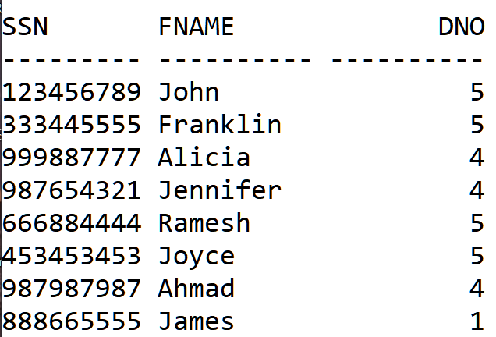
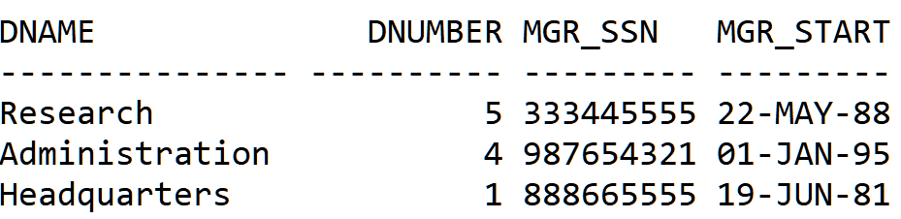
Cartesian Join
Employee
Department
Output:
Total No. of Rows = 8*3 = 24
Total No. of Columns = No. of Col. in Employee + No. of Col. in Department = 7

Slide 75
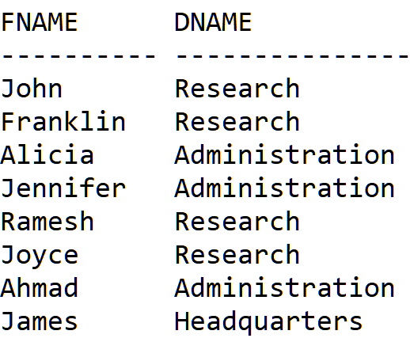
Inner Join – EQUI JOIN
SELECT FNAME, DNAME
FROM EMPLOYEE E, DEPARTMENT D
WHERE E.DNO = D.DNUMBER;

Slide 76
Inner Join…
SELECT SSN, DNAME
FROM EMPLOYEE E
INNER JOIN DEPARTMENT D ON E.DNO = D.DNUMBER;

Slide 77
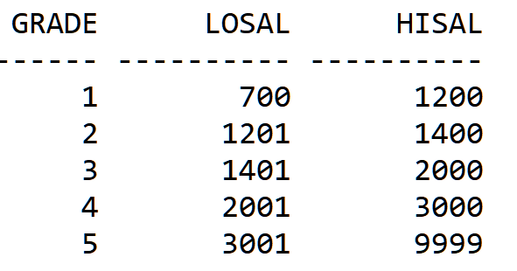
Non-Equi Join
SELECT E.FNAME, E.SALARY, S.GRADE
FROM EMPLOYEE E, SALGRADE S
WHERE E.SALARY BETWEEN S.LOSAL AND S.HISAL;
SALGRADE

Slide 78
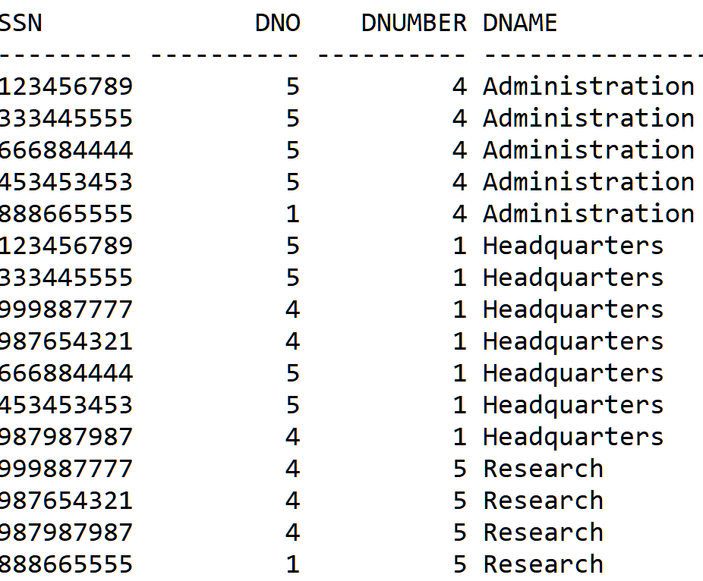
Non-Equi Join (Contd.)
SELECT E.SSN, E.DNO, D.DNUMBER,D.DNAME
FROM EMPLOYEE E, DEPARTMENT D
WHERE E.DNO<>D.DNUMBER;

Slide 79
Self Join
SELECT E1.FNAME, E1.SALARY
FROM EMPLOYEE E1, EMPLOYEE E2
WHERE (E1.SALARY > E2.SALARY) AND (E2.FNAME = ‘JAMES');

Slide 80
NESTED QUERIES or SUB QUERIES
SELECT E1.FNAME, E1.SALARY
FROM EMPLOYEE E1
WHERE E1.SALARY >
( SELECT E2.SALARY
FROM EMPLOYEE E2
WHERE E2.FNAME = ‘JAMES');
Outer Query
Which Employees draw Salary greater than Scott?
Inner Query
What is James’s Salary?

Slide 81
Who draws highest Salary?
SELECT FNAME, MAX(SALARY)
FROM EMPLOYEE
SELECT FNAME, SALARY
FROM EMPLOYEE
WHERE SALARY =
(SELECT MAX(SALARY)
FROM EMPLOYEE);
This is wrong!

Slide 82
Multiple-Row Subquery
Operator | Description
IN | Equal to any member in the list.
ANY | Compare value to each value returned by the subquery
ALL | Compare value to all the values returned by the subquery
Operator | Meaning | Example
< ANY | Less than the Maximum | e < ANY (5,3,8): e is less than any single item in the list (5,3,8). Even 7 qualifies, because 7 < 8.
> ANY | More than the minimum | e > ANY (5,3,8): e is less than any single item in the list (5,3,8). Even 4 qualifies, because 4 > 3
= ANY | Same as IN | e = ANY(5,3,8). All values in the list qualify
< ALL | Less than the maximum | e < ALL (5,3,8): Anything below 3 qualifies
> ALL | More than the minimum | e > ALL (5,3,8): Anything greater than 8 qualifies
!= ALL | Not equal to anything | e != (5,3,8): Anything other than 5,3, and 8 qualifies

Slide 83
Which Department has lowest payroll?
SELECT DNO
FROM EMPLOYEE
GROUP BY DNO
HAVING SUM(SALARY)
<= ALL (
SELECT SUM(SALARY)
FROM EMPLOYEE
GROUP BY DNO
);
DNO SUM(SALARY)
---------- ------------------------
1 55000
5 133000
4 93000

Slide 84
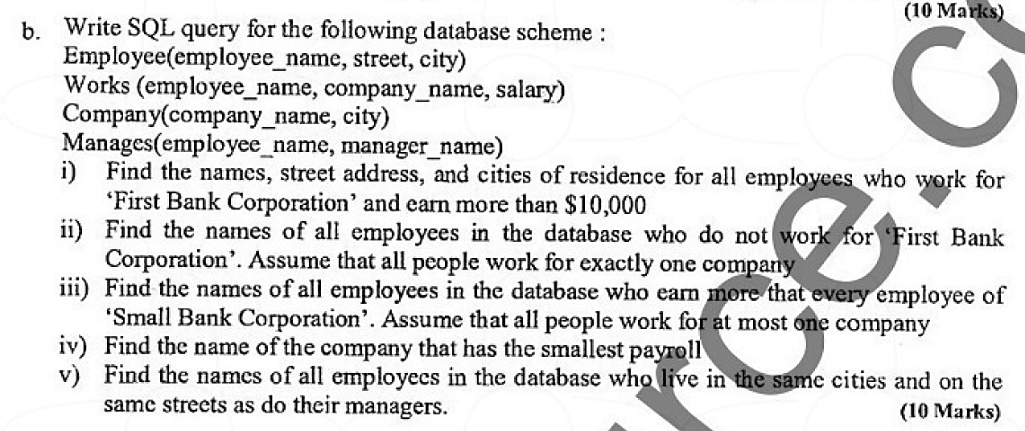
VTU QP - FEB 2021

Slide 85
QUERY 1
SELECT E.employee_name, E.street, E.city
FROM Employee E, Works W
WHERE E.employee_name = W.employee_name AND
E.salary > 10000 AND
W.company_name = ‘First Bank Corporation’;

Slide 86
QUERY 2
SELECT E.employee_name, E.street, E.city
FROM Employee E, Works W
WHERE E.employee_name = W.employee_name AND
W.company_name <> ‘First Bank Corporation’;

Slide 87
QUERY 3
SELECT EMPLOYEE_NAME, SALARY
FROM EMPLOYEE
WHERE SALARY >ALL
(SELECT SALARY
FROM WORKS
WHERE COMPANY_NAME = ‘First Bank Corporation’);
);

Slide 88
QUERY 4
SELECT CNAME
FROM WORKS
GROUP BY CNAME
HAVING SUM(SALARY)
<= ALL
(SELECT SUM(SALARY)
FROM WORKS
GROUP BY CNAME
);

Slide 89
QUERY 5
SELECT E.EMPLOYEE_NAME, E.STREET, E.CITY
FROM EMPLOYEE E
WHERE E.CITY AND E.STREET IN
(
SELECT E.CITY, E.STREET
FROM EMPLOYEE E, MANAGES M
WHERE E.EMPLOYEE_NAME = M.MANAGER_NAME
);

Slide 90
SQL Queries Company DB

Slide 91
Company Database Queries

Slide 92
Contd…

Slide 93
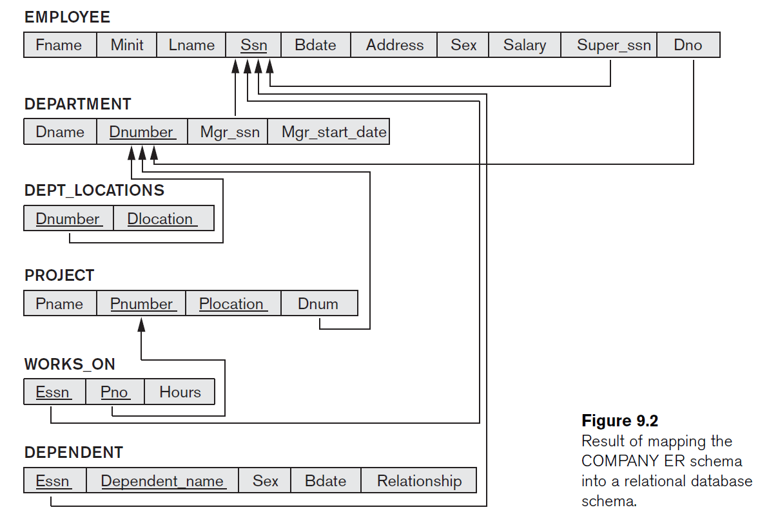
Company DB Schema

Slide 94
Company Database Queries…
Q1: Retrieve the birth date and address of the employee(s)
whose name is ‘John B. Smith’.
SELECT Bdate, Address
FROM EMPLOYEE
WHERE Fname=‘John’ AND Minit=‘B’ AND Lname=‘Smith’;

Slide 95
Company Database Queries…
Q2: Retrieve the name and address of all employees who work for the ‘Research’ department.
SELECT Fname, Lname, Address
FROM EMPLOYEE, DEPARTMENT
WHERE Dname=‘Research’ AND Dnumber=Dno;

Slide 96
Company Database Queries…
Q3: For every project located in ‘Stafford’, list the project number, the controlling department number, and the department manager’s last name, address, and birth date.
SELECT Pnumber, Dnum, Lname, Address, Bdate
FROM EMPLOYEE, DEPARTMENT, PROJECT
WHERE Dnum=Dnumber AND Mgr_ssn=Ssn AND
Plocation=‘Stafford’;

Slide 97
Company Database Queries…
Q4: For each employee, retrieve the employee’s first and last name and the first and last name of his or her immediate supervisor.
SELECT E.Fname, E.Lname, S.Fname, S.Lname
FROM EMPLOYEE E, EMPLOYEE S
WHERE E.Super_ssn=S.Ssn;
Q5: Retrieve the names of all employees who do not have supervisors.
SELECT Fname, Lname
FROM EMPLOYEE
WHERE Super_ssn IS NULL;

Slide 98
Company Database Queries…
Q6: Get the Essns of all employees who work the same (project, hours) combination on some project that employee ‘John Smith’ (whose Ssn = ‘123456789’) works on
SELECT DISTINCT Essn
FROM WORKS_ON
WHERE (Pno, Hours) IN
( SELECT Pno, Hours
FROM WORKS_ON
WHERE Essn=‘123456789’ );

Slide 99
Company Database Queries…
Q7: Find the names of employees whose salary is greater than the salary of all the employees in department 5.
SELECT Lname, Fname
FROM EMPLOYEE
WHERE Salary > ALL
( SELECT Salary
FROM EMPLOYEE
WHERE Dno=5 );

Slide 100
Company Database Queries…
Q8: Retrieve the name of each employee who has a dependent with the same first name and is the same sex as the employee.
SELECT E.Fname, E.Lname
FROM EMPLOYEE E
WHERE EXISTS (
SELECT *
FROM DEPENDENT D
WHERE E.Ssn=D.Essn
AND E.Sex=D.Sex
AND E.Fname=D.Dependent_name);

Slide 101
Company Database Queries…
Q9: Retrieve the total number of employees in the ‘Research’ department.
SELECT COUNT (*)
FROM EMPLOYEE, DEPARTMENT
WHERE DNO=DNUMBER AND DNAME=‘Research’;
Q10: Find the sum of the salaries of all employees of the ‘Research’ department, as well as the maximum salary, the minimum salary, and the average salary in this department.
SELECT SUM (Salary), MAX (Salary),
MIN (Salary), AVG (Salary)
FROM (EMPLOYEE JOIN DEPARTMENT ON Dno=Dnumber)
WHERE Dname=‘Research’;

Slide 102
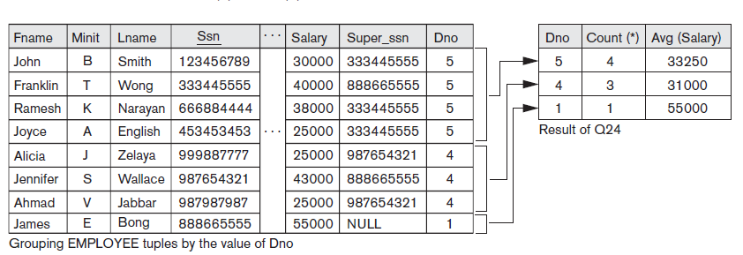
Company Database Queries…
Q11: For each department, retrieve the department number, the number of employees in the department, and their average salary.
SELECT Dno, COUNT (*), AVG (Salary)
FROM EMPLOYEE
GROUP BY Dno;

Slide 103
Company Database Queries…
Q12: For each project on which more than two employees work, retrieve the project number, the project name, and the number of employees who work on the project.
SELECT Pnumber, Pname, COUNT (*)
FROM PROJECT, WORKS_ON
WHERE Pnumber=Pno
GROUP BY Pnumber, Pname
HAVING COUNT (*) > 2;

Slide 104
Company Database Queries…
Q13: For each department that has more than five employees, retrieve the department number and the number of its employees who are making more than $40,000.
SELECT Dnumber, COUNT (*)
FROM DEPARTMENT, EMPLOYEE
WHERE Dnumber = Dno AND Salary > 40000 AND
( SELECT Dno
FROM EMPLOYEE
GROUP BY Dno
HAVING COUNT (*) > 5);

Slide 105

Examples from Raghu Ramakrishnan
Sailors(sid: integer, sname: string, rating: integer, age: real)
Boats(bid: integer, bname: string, color: string)
Reserves(sid: integer, bid: integer, day: date)

Slide 106
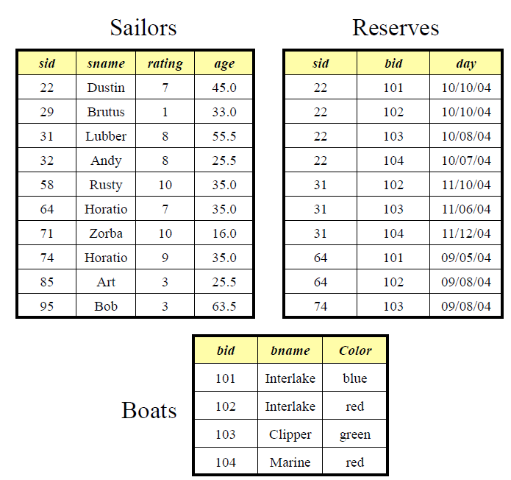
Sample Database

Slide 107
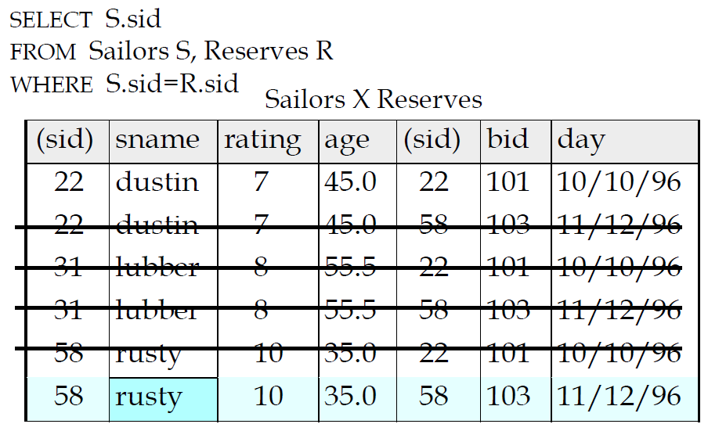
Query 1
Find sailors who’ve reserved at least one boat

Slide 108
Query 2
Find sid’s of sailors who’ve reserved a red or a green boat.
SELECT DISTINCT S.sid
FROM Sailors S, Boats B, Reserves R
WHERE S.sid = R.sid AND R.bid=B.bid
AND
(B.color=‘red’ OR B.color=‘green’)

Slide 109



Query 2 (Option 2)
SELECT S.sid
FROM Sailors S, Boats B, Reserves R
WHERE S.sid=R.sid AND R.bid=B.bid AND B.color=‘red’
UNION
SELECT S.sid
FROM Sailors S, Boats B, Reserves R
WHERE S.sid=R.sid AND R.bid=B.bid AND B.color=‘green’

Slide 110

Query 3
Find sid’s of sailors who’ve reserved a red and a green boat
SELECT S.sid
FROM Sailors S, Boats B, Reserves R
WHERE S.sid=R.sid AND R.bid=B.bid AND B.color=‘red’
INTERSECT
SELECT S.sid
FROM Sailors S, Boats B, Reserves R
WHERE S.sid=R.sid AND R.bid=B.bid AND B.color=‘green’

Slide 111
Query 4
Find names of sailors who’ve reserved boat #103
SELECT S.sname
FROM Sailors S
WHERE S.sid IN
(SELECT R.sid
FROM Reserves R
WHERE R.bid=103);
Subquery result does not change with each new Sailor row.
Nested query is executed only once.

Slide 112
Query 5
Find names of sailors who’ve reserved boat #103
SELECT S.sname
FROM Sailors S
WHERE S.sid EXISTS
(SELECT *
FROM Reserves R
WHERE R.bid=103 AND S.sid=R.sid);
Correlation: subquery finds all reservations for bid 103 from current sid
In case of correlation, subquery must be recomputed for each Sailors tuple.

Slide 113
Query 6
Find the sids of all sailors who have reserved red boats but not green boats
SELECT S.sid
FROM Sailors S, Boats B, Reserves R
WHERE S.sid=R.sid AND R.bid=B.bid AND B.color=‘red’
MINUS
SELECT S2.sid
FROM Sailors S2, Boats B2, Reserves R2
WHERE S2.sid=R2.sid AND R2.bid=B2.bid AND B2.color=‘green’;

Slide 114
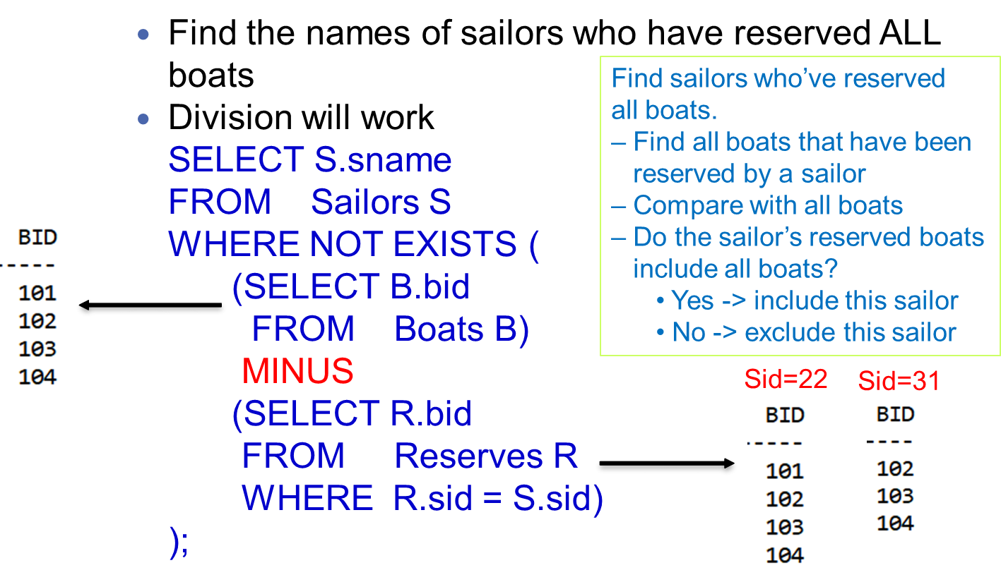
Query 7

Slide 115
Query 7 – Method 2
SELECT S.sname
FROM Sailors S
WHERE NOT EXISTS
(SELECT B.bid
FROM Boats B
WHERE NOT EXISTS
(SELECT R.bid
FROM Reserves R
WHERE R.bid = B.bid AND R.sid = S.sid)
);

Slide 116
Exercises
Write SQL query with and without EXISTS clause to find the total sales of southern region.
SELECT SUM(Sales) Ans: $2050
FROM Store WHERE EXISTS (SELECT *
FROM Location WHERE Region_name = ‘South’ AND Store.Store_name = Location.Store_name);
Store
Location
Store_name | Sales | Date
Chennai | 1500 | Jan-05-2017
Bangalore | 250 | Jan-07-2017
Chennai | 300 | Jan-08-2017
Delhi | 700 | Jan-08-2017
Region_name | Store_name
North | Delhi
South | Chennai
South | Bangalore
South | Hyderabad

Slide 117
Without EXISTS
SELECT SUM(Sales)
FROM Store
WHERE Store_name IN
(SELECT Store_name
FROM Location
WHERE Region_name = 'South');
SELECT SUM(Sales)
FROM Store S, Location L
WHERE S.Store_name = L.Store_name AND L.Region_name = 'South';

Slide 118
Exercise #4:
STUDENT (SID, Sname, Branch)
FACULTY (FID, Fname, Dept, Designation, Salary)
COURSE (CID, CName, Credits)
ENRO (SID, CID, GRADE)

Slide 119
Query 1
STUDENT (SID, Sname, Branch)
FACULTY (FID, Fname, Dept, Designation, Salary)
COURSE (CID, CName, Credits)
ENROLL (SID, CID, GRADE)
Give 15% salary hike to all faculty.
UPDATE FACULTY
SET Salary = Salary*1.15;

Slide 120
Query 2
STUDENT (SID, Sname, Branch)
FACULTY (FID, Fname, Dept, Designation, Salary)
COURSE (CID, CName, Credits)
ENROLL (SID, CID, GRADE)
List all the departments having an average salary of above ₹20,000
SELECT DEPT, AVG(SALARY)
FROM FACULTY
GROUP BY DEPT
HAVING AVG(SALARY) > 20000;

Slide 121
Query 3
STUDENT (SID, Sname, Branch)
FACULTY (FID, Fname, Dept, Designation, Salary)
COURSE (CID, CName, Credits)
ENROLL (SID, CID, GRADE)
List the names of all faculty members beginning with ‘R’ and ending with ‘U’.
SELECT FNAME
FROM FACULTY
WHERE FNAME LIKE R%U;

Slide 122
Query 4
STUDENT (SID, Sname, Branch)
FACULTY (FID, Fname, Dept, Designation, Salary)
COURSE (CID, CName, Credits)
ENROLL (SID, CID, GRADE)
List names of all the students enrolled for the course ‘CS53’
and have received ‘S’ grade.
SELECT SNAME
FROM STUDENT S, ENROLL E
WHERE S.SID = E.SID AND E.CID = ‘CS53’ AND E.GRADE = ‘S’;

Slide 123
Summary

